Slide 1
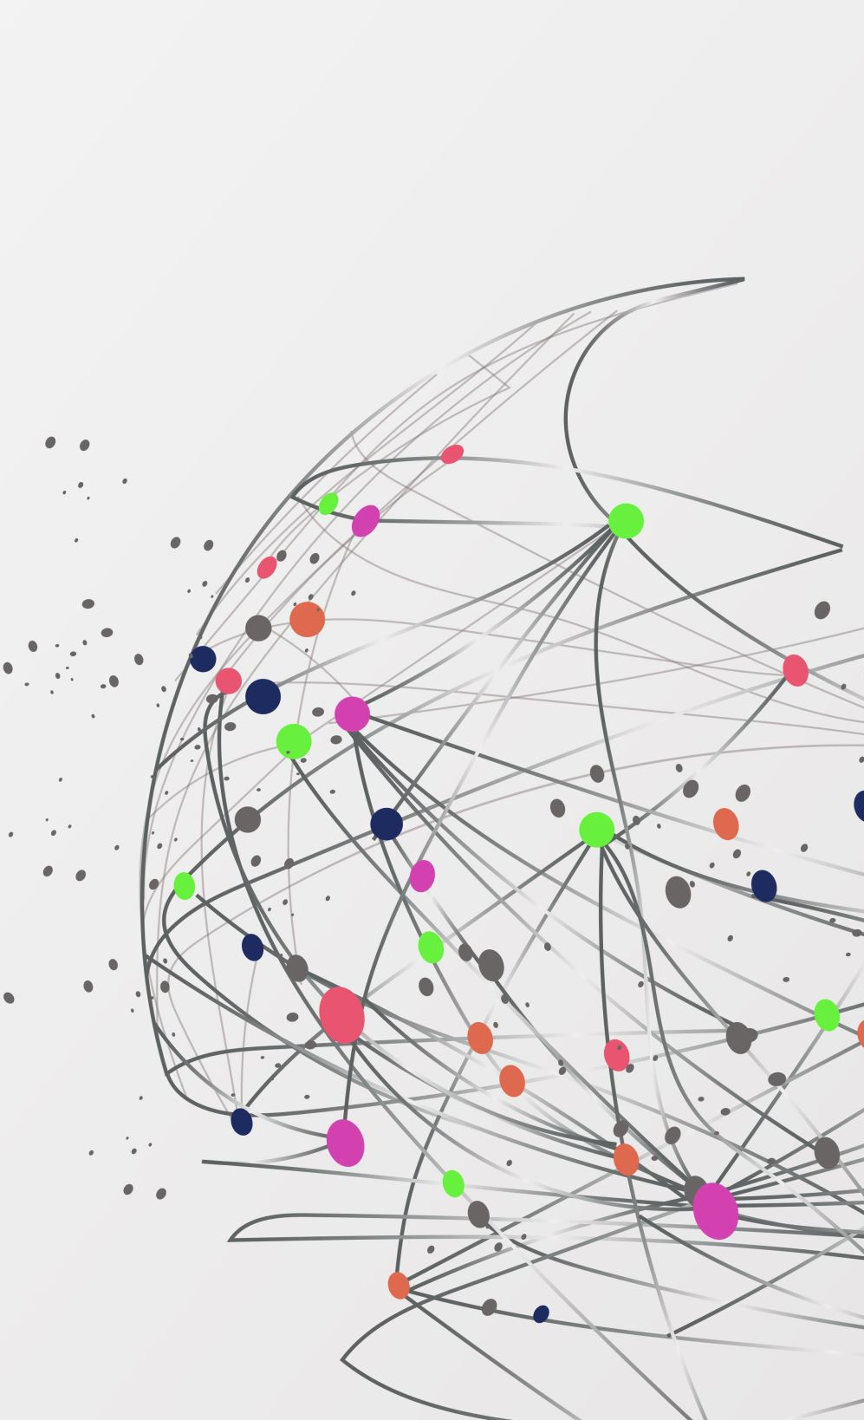
Scaling Social Media: A Study on Distributed Database Systems in Modern Platforms like Facebook
Exploring the Backbone of Social Media Infrastructure

Slide 2
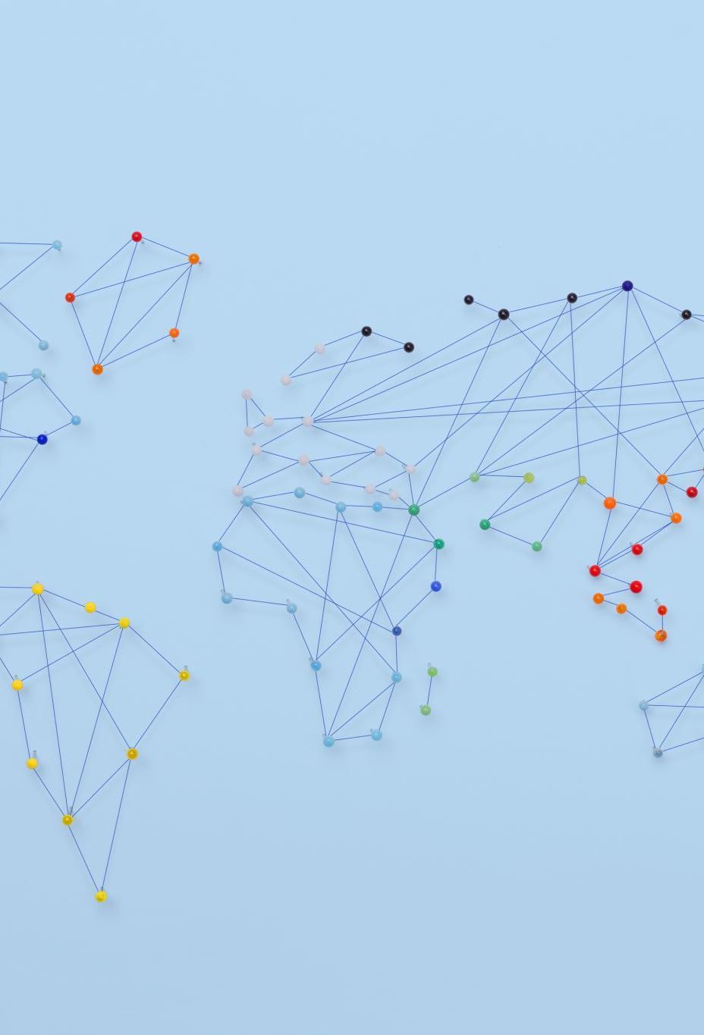
Introduction
In today's digital age, social media has transformed the way we communicate, connect, and consume information. Platforms like Facebook, Twitter, and Instagram have become integral parts of our daily lives, influencing how we interact with one another and the world around us.
With billions of users worldwide and millions of interactions happening every second, social media platforms have become massive hubs of activity, generating vast amounts of data every day.

Slide 3
To support this immense scale and ensure a seamless user experience, social media platforms require robust and efficient infrastructure. One critical component of this infrastructure is distributed database systems.
Distributed database systems are the backbone of social media platforms, enabling them to store, manage, and retrieve massive amounts of data efficiently. These systems allow platforms to scale horizontally, adding more servers and nodes as needed to handle increasing data volumes and user traffic.

Slide 4
Without distributed database systems, platforms like Facebook would struggle to provide a seamless user experience. Tasks like loading user profiles, displaying news feeds, and processing user interactions would be slow and prone to errors.
Social media data is not only vast but also complex, with relationships between users, their connections, and the content they interact with. Distributed database systems are designed to handle this complexity, ensuring data consistency, availability, and reliability.

Slide 5
Evolution of Distributed Database Systems in Social Media Platforms
The evolution of distributed database systems in social media platforms can be traced back to the early 2000s when social networking sites began to gain popularity. Initially, these platforms relied on centralized architectures, where all data was stored and managed on a single server.
One of the earliest milestones in the adoption of distributed systems was the emergence of platforms like Friendster and MySpace, which struggled to cope with the rapid growth of their user bases and the increasing volume of data generated by users.

Slide 6
Early social networking sites faced challenges related to scalability, as centralized architectures were unable to handle the growing number of users and the increasing complexity of social interactions. Performance issues, such as slow loading times and service disruptions, were common.
The adoption of distributed database systems, such as MySQL Cluster and Apache Cassandra, marked a significant shift in how social media platforms managed their data. These systems allowed platforms to distribute data across multiple nodes, improving scalability and performance.

Slide 7
The transition to distributed architectures revolutionized scalability and performance in social media platforms. By distributing data across multiple nodes, platforms were able to scale horizontally, adding more servers and nodes to accommodate growing user bases and data volumes. This approach also improved fault tolerance, as data was replicated across multiple nodes, ensuring high availability.
Overall, the shift from centralized to distributed architectures has had a profound impact on the social media industry, enabling platforms to provide a seamless user experience and support the massive scale of modern social networking.

Slide 8
Key Features of Distributed Database Systems
Partitioning
Replication
Data partitioning is the process of dividing a database into smaller, more manageable parts called partitions.
Partitioning allows for parallel processing, where multiple nodes can work on different partitions simultaneously, improving overall query performance and scalability.
For example, in a social media platform, user data could be partitioned based on geographic regions, allowing queries for users in specific regions to be processed more efficiently.
Replication involves creating and maintaining copies of data across multiple nodes in a distributed database system.
Replication is crucial for fault tolerance, as it ensures that data remains accessible even if some nodes fail.
By replicating data, distributed database systems can ensure high availability, allowing users to access data even during network failures or maintenance activities.

Slide 9
Consistency Models
Query Optimization
Consistency models define how and when updates to data are propagated across distributed nodes.
One common consistency model in social media platforms is eventual consistency, where updates are eventually propagated to all nodes, ensuring availability even in the presence of network partitions.
Some platforms may opt for strong consistency models, where updates are immediately propagated to all nodes, ensuring data consistency but potentially impacting performance.
Query optimization techniques are used to improve the efficiency of data retrieval operations in distributed database systems.
In social media platforms, where complex queries involving multiple data sources are common, query optimization is crucial for ensuring fast and accurate query results.
Techniques such as index selection, query rewriting, and parallel query processing can significantly improve query performance in distributed systems.

Slide 10
Industry Usage of Distributed Database Systems
Scalability
Fault Tolerance
Scalability refers to the ability of a system to handle increasing workloads by adding more resources.
horizontal scalability, Distributed database systems enable social media platforms to scale horizontally, meaning they can add more servers and nodes to accommodate growing user bases and data volumes.
For instance, Facebook uses Apache Cassandra to scale its messaging platform, allowing it to handle billions of messages per day from users around the world.
Fault tolerance is the ability of a system to continue operating in the event of hardware or software failures.
Distributed systems' resilience, Distributed database systems achieve fault tolerance by replicating data across multiple nodes, ensuring that if one node fails, data remains accessible from other nodes.
For example, Twitter uses a distributed key-value storage system called Manhattan to ensure that tweets remain accessible even if some servers fail.

Slide 11
High Availability
Real-time Analytics
High availability refers to the ability of a system to remain operational and accessible even during maintenance activities or hardware failures.
Distributed database systems ensure high availability by replicating data and distributing it across multiple nodes, so even if some nodes are unavailable, data can still be accessed from other nodes.
LinkedIn relies on Apache Kafka for its messaging platform, ensuring that messages remain accessible to users even during maintenance or hardware failures.
Real-time analytics involves processing and analysing data as it is generated, allowing for immediate insights and decision-making.
Distributed database systems enable real-time analytics by providing fast and efficient access to data across multiple nodes, allowing platforms to derive valuable insights from user data.
For instance, Instagram uses distributed systems to analyse user interactions in real-time, allowing them to personalize content and enhance user engagement.

Slide 12

Facebook's Use of Apache Cassandra and Apache HBase
Facebook uses Apache Cassandra for its messaging platform and Apache HBase for real-time analytics, showcasing scalability and performance benefits.
Apache Cassandra allows Facebook to handle billions of messages per day, ensuring high performance and reliability.
Apache HBase enables Facebook to analyse large volumes of data quickly and efficiently, supporting real-time decision-making.
Notes:
Scalability: Cassandra is designed for high scalability and can handle large amounts of data across multiple nodes. This is crucial for Facebook, which deals with massive amounts of user-generated content.
Fault Tolerance: Cassandra is fault-tolerant, meaning it can continue to operate even if some nodes in the cluster fail. This ensures that Facebook can maintain its services without interruptions.
Consistency: Facebook uses a tunable consistency model in Cassandra, allowing them to balance between consistency and performance based on their needs.
Use Case: Facebook uses Cassandra for its messaging platform, which requires handling a large volume of messages and ensuring high availability.

Slide 13

Twitter's Use of Manhattan
Twitter a popular microblogging platform, experienced rapid growth in its user base, resulting in a significant increase in tweet data.
To manage this growth, Twitter developed Manhattan, a distributed key-value storage system that allows for efficient storage and retrieval of tweet data.
Manhattan's architecture enables Twitter to scale its infrastructure horizontally, adding more servers and nodes as needed to accommodate the growing volume of tweet data. This approach has allowed Twitter to support its rapid growth while maintaining high levels of performance and reliability.
Notes:
Key-Value Store: Manhattan is a distributed key-value storage system developed by Twitter to handle the high volume of tweets and user interactions on its platform.
Distributed Design: Manhattan is designed to be distributed across multiple nodes, allowing Twitter to scale horizontally as its user base and data volume grow.
Scalability: Manhattan is highly scalable and can handle millions of tweets per minute, making it ideal for a platform like Twitter with a large and active user base.

Slide 14
LinkedIn's Use of Apache Kafka
LinkedIn, a professional networking platform, relies on a robust messaging platform to facilitate communication among its users."
To ensure reliable message delivery at scale, LinkedIn uses Apache Kafka, a distributed streaming platform that allows for the efficient and reliable processing of large volumes of data.
Apache Kafka's architecture enables LinkedIn to guarantee the delivery of messages, even in the event of network failures or server outages. This ensures that users can communicate seamlessly on the platform, enhancing their overall experience.
Notes:
Distributed Streaming Platform: Kafka is a distributed streaming platform that is designed to handle large volumes of data streams in a scalable, fault-tolerant, and real-time manner.
Publish-Subscribe Model: Kafka uses a publish-subscribe messaging model, where producers publish messages to topics, and consumers subscribe to topics to receive messages.
Scalability: Kafka is highly scalable and can handle millions of messages per second across multiple nodes, making it suitable for use cases that require high throughput and low latency.

Slide 15

Ensuring Compliance
Data Privacy Regulations: Distributed database systems play a crucial role in helping social media platforms comply with stringent data privacy regulations such as GDPR (General Data Protection Regulation) and CCPA (California Consumer Privacy Act). For example, consider the GDPR's requirement for data localization. By using distributed database systems, social media platforms can store data in specific geographic locations, ensuring compliance with GDPR's data residency requirements. Additionally, these systems enable access control mechanisms, allowing platforms to restrict access to sensitive data based on user roles or permissions. Furthermore, encryption techniques employed by distributed systems help protect data from unauthorized access, ensuring compliance with GDPR's data protection principles.

Slide 16
Audit Trails
Distributed database systems maintain comprehensive audit trails, which are essential for compliance and accountability. For example, let's consider a scenario where a social media platform needs to demonstrate compliance with GDPR's accountability principle. By using distributed database systems, the platform can track and record all data access and modifications, creating a detailed audit trail. This audit trail can be used to demonstrate compliance during audits or investigations, showcasing the platform's commitment to data protection and accountability.

Slide 17

Enhancing Security
Data Encryption: Distributed systems often use encryption to secure data both at rest and in transit, reducing the risk of unauthorized access.
Access Control: They provide granular access control mechanisms, ensuring that only authorized personnel can access sensitive information.

Slide 18
Improving Performance and Reliability
Load Balancing: Distributed systems distribute workload evenly across nodes, optimizing performance and ensuring high availability.
Fault Tolerance: They replicate data across multiple nodes, ensuring that the system remains operational even in the event of hardware failures or network issues.

Slide 19
Insights Gained from Researching the Topic
Researching distributed database systems in social media platforms has provided valuable insights into the intricate infrastructure required to support modern technology. It has highlighted the challenges of managing massive amounts of data and the importance of scalability and fault tolerance.
One key takeaway is the critical role of distributed database systems in enabling social media platforms to handle immense amounts of user-generated content and interactions. Additionally, the research has underscored the importance of continuous innovation and adaptation to meet the evolving needs of users.

Slide 20
Future Scope
Scalability is crucial for accommodating growing user bases and data volumes. This research emphasizes the importance of scalable solutions in ensuring that systems can handle increased loads without sacrificing performance.
Fault tolerance is essential for maintaining system reliability and availability. By studying distributed database systems in social media platforms, we can understand how to design systems that can tolerate failures and ensure continuous operation.
High availability is critical for ensuring uninterrupted service, especially in mission-critical applications. This research highlights the significance of high availability in providing users with seamless access to services.

Slide 21
Conclusion
In conclusion, this presentation has highlighted the profound impact of distributed database systems on social media platforms like Facebook, Twitter, LinkedIn, and Instagram. It has emphasized the importance of scalability, fault tolerance, and high availability in ensuring the reliability and performance of these platforms.
The research has underscored the significance of distributed database systems in supporting the scale and complexity of modern social networking, enabling seamless user experiences and fostering innovation within the industry.
Looking ahead, it is clear that distributed database systems will continue to play a crucial role in shaping the future of social media platforms. Emerging trends such as machine learning-driven optimization and blockchain integration are poised to further enhance the scalability, reliability, and performance of these systems.

Slide 22
THANK YOU

